Slide 1
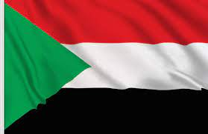
Sudan

Slide 2
Sudan, officially the Republic of the Sudan, is a country in Northeast Africa. It borders the countries of Central African Republic, Chad, Egypt, Eritrea, Ethiopia, Libya, South Sudan, and the Red Sea.
Area: 1.886 million km²
Currency: Sudanese pound
Population: 43.85 million (2020)
Official languages: Arabic, English

Slide 3
Some facts about Sudan
While Egypt gets noticed for its pyramids, Sudan is known as the place with the world's largest collection of pyramids. There are over 200 recorded pyramids in the country.
Over 97% of Sudan's population is Muslim. They practice in the Sunni tradition.
Sudan’s capital is Khartoum. In Arabic, Khartoum means elephant trunk, and the capital has an area of 22,142 square kilometers. In 2014, the population was recorded at 5 million.

Slide 4
Here’s why Sudan is one of the least developed country
Hard climate conditions and lack of natural resources contribute to poverty in Sudan. The internal conflict and political instability have intensified the poor conditions.

Slide 5
Food
Ful medames (fava beans dish) Ful medames is known as the national dish of Sudan.
Kisra is a popular thin fermented bread made in Sudan and South Sudan.

